Slide 1
Mental Health First Aid

Slide 2
Train as a Mental Health First Aider and receive three years of support and benefits
This course is ideal for those who would like to become an MHFAider® to:
Gain the knowledge and skills to spot signs of people experiencing poor mental health
Be confident starting a conversation and signpost a person to appropriate support
Alongside the best evidence-based Mental Health First Aid training, MHFAiders are also provided with three-year access to ongoing learning and support through the MHFAider Support App®.
The app gives you 24/7 digital support, access to exclusive resources, ongoing learning opportunities, and the benefit of joining England’s largest community of trained MHFAiders.

Slide 3
Benefits of our Mental Health First Aid course
Reduces stigma around mental ill health
Gives you increased confidence to have a supportive conversation about mental health
Promotes equity and understanding around mental health from different perspectives
Helps to build supportive communities and promotes open conversations about mental health
Encourages self-care, giving you the tools to look after your own and others' mental health
Promotes early intervention and recovery, which can prevent an individual's mental health deteriorating

Slide 4
Learning outcomes
As an MHFAider you will be able to:
Recognise those that may be experiencing poor mental health and provide them with first-level support and early intervention
Encourage a person to identify and access sources of professional help and other supports
Practise active listening and empathy
Have a conversation with improved mental health literacy around language and stigma
Discuss the role in depth, including boundaries and confidentiality
Practise self-care

Slide 5
MHFAider support
MHFA® training doesn't stop when the course comes to an end. MHFA England offers continuous support for MHFAiders, well beyond your initial certification, to ensure you can lead impactful MHFA interventions.
As an MHFAider you will get automatic 24/7 digital support through the MHFAider Support App. From there, you'll find exclusive resources, ongoing learning opportunities to grow your confidence, and gain the benefit of joining England’s largest community of trained MHFAiders.​
This support will give you an opportunity to:
Keep your learning alive
Quickly reference something
Connect you with a group of people improving the mental health of the nation
​

Slide 6
MHFAider Support App

Slide 7
MHFAider Support App
The app empowers you as MHFAider with the following features:
Secure conversation logging for you to make reflective notes to record and reflect while protecting confidentiality
Reminders for wellbeing check-ins with people you are supporting
24/7 text support service through Shout, for advice and reassurance on a Mental Health First Aid conversation or to support your own wellbeing after a difficult conversation
Resource library of toolkits, guidance, animations and core mental health concepts to support the you in your role as MHFAider
Signposting database through Hub of Hope to find local and national mental health services for additional support

Slide 8
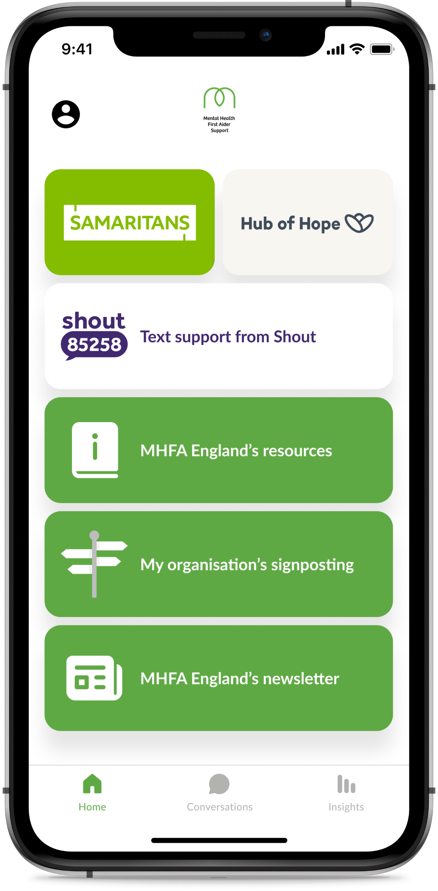
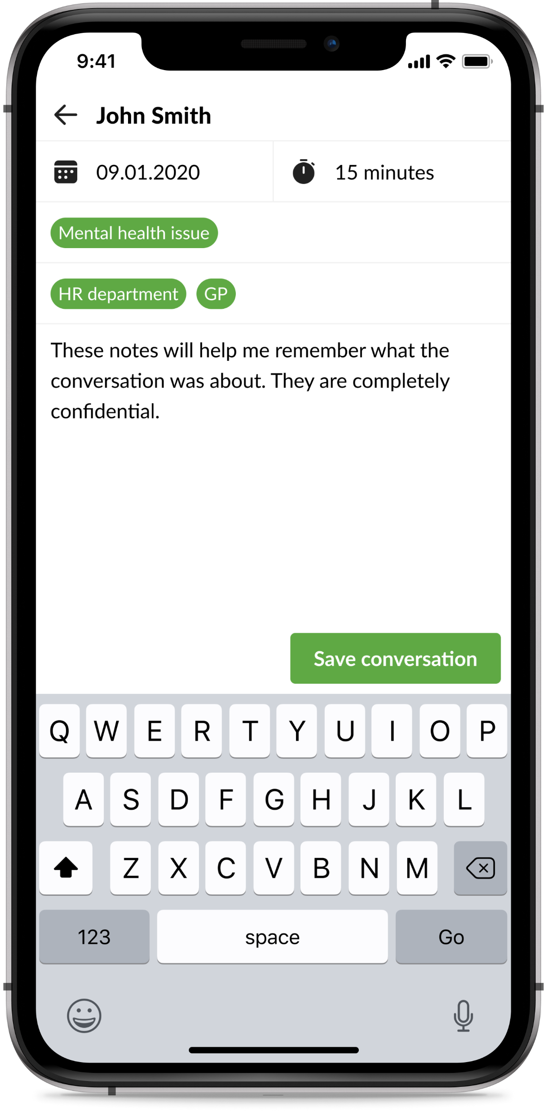
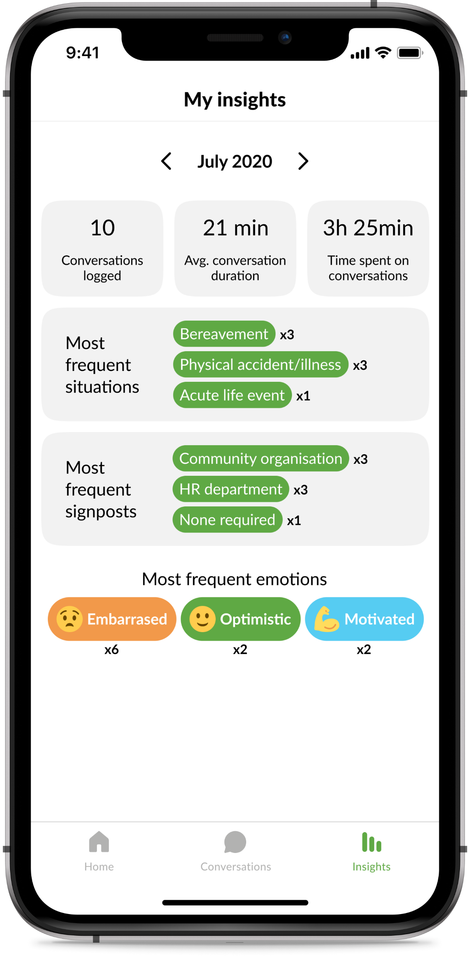
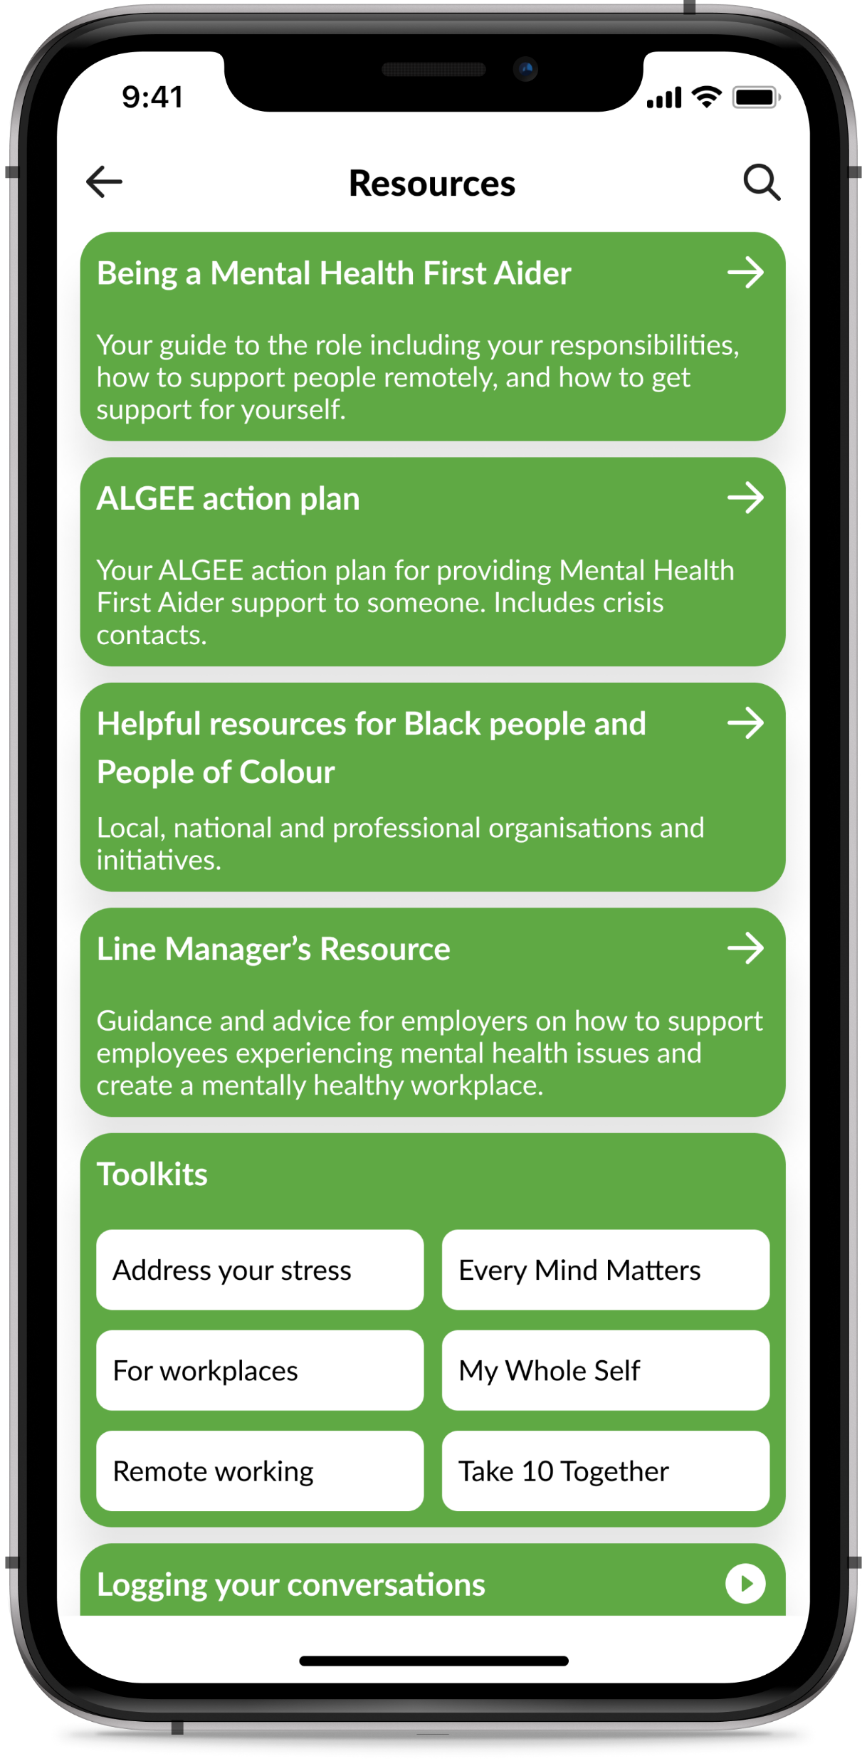
MHFAider Support App features
Home screen
Conversation logging
Insights
Resource library

Slide 9
MHFAider learning

Slide 10
MHFAider learning
As an MHFAider you’ll also have access to ongoing learning to support you in the role and ensure you have the most up-to-date information on mental health.
Over the three years, you will benefit from:
A library of resources that will support you to have impactful conversations
MHFAider online events, exploring different topics and themes around mental health and the MHFAider role
Exclusive MHFAider content, regular online events to provide further learning and support so you are confident to perform your role effectively, long after your training

Slide 11
Why MHFA England training?
91% of people had a better understanding of mental health after completing their MHFA England course
Since MHFA England was founded in 2007, our Instructor Members have trained hundreds and thousands of MHFAiders
All MHFA England Instructor Members are accredited by the Royal Society of Public Health, meaning you can expect a quality assured and consistent training experience
We are committed to improving the mental health of the nation

Slide 12
RSPH Level 3 Award in Mental Health First Aid

Slide 13
RSPH Level 3 Award in Mental Health First Aid
MHFA England has partnered with Royal Society for Public Health (RSPH) to create an Office for Qualifications and Examinations Regulation (Ofqual) regulated qualification.
By attending the MHFA course, you are eligible to take the eAssessment to gain your MHFAider qualification.
RSPH Level 3 Award in Mental Health First Aid gives you the opportunity to:
Embed your learning further
Build confidence in your ability to carry out the role
Demonstrate your expertise and commitment

Slide 14
Thank you

